Slide 1
Detroit Region SCCA
2020 Awards
Welcome
7 pm
May 19, 2021

Slide 2
Housekeeping
Masks are not required for our virtual gathering
Please place your device on mute
Please put questions into chat
Video is optional
Check the DRSCCA Website for more information

Slide 3
Detroit Region SCCA
2020 Awards
THANK YOU Event Chairs

Slide 4
2020 Detroit Region Events & Chairpersons
RACE CHAIRS
April 25-26, 2020 | Drivers School | Waterford Hills Waterford, MI | Alejandro Della Torre
June 27-28, 2020 | Regional | Waterford Hills Waterford, MI | Nick Aranda
RALLYCROSS CHAIRS
Matt Wolfe Jennifer Glass

Slide 5
2020 Detroit Region Events & Chairpersons
SOLO CHAIRS
June 26-28 Test and Tune Marissa Solnik
July 5 Summer Heat Solo Greg Valade
July 31-August 2 Oscoda Test Tune Drive Marcus Meredith
August 9 Dog Daze Greg Valade
August 22-23 Before Nationals Ray Jason
September 20 Fall into Autumn Keith Armitage
October 4 Autumn Colors Solo Karl Riggs
October 18 Season Ender John Li

Slide 6
2020 Detroit Region Events & Chairpersons
RALLY CHAIRS
January 12 | Son of Snow Drift XXI Aubree’s Pizzeria and Grill in South Lyon, MI | Scott Harvey
September 12-13 | Press On Regardless Hampton Inn in Gaylord, MI | Bruce Fisher
November 13 | Hell and Back (USRRC Tour) Days Inn in Whitmore Lake, MI | Scott Harvey
November 14 | Pavement Ends (USRRC Tour) Days Inn in Whitmore Lake, MI | John Kytasty
November 15 | Are You Territorial? (USRRC Course) Days Inn in Whitmore Lake, MI | Bruce Fisher
November 13-15 | USRRC Overall Days Inn in Whitmore Lake, MI | Piotr Roszczenko
Son of Sno*Drift XXII

Slide 7
Detroit Region SCCA
2020 Awards
Congratulations
Award Winners

Slide 8
2020 Awards
Congratulations
Race
Rally
RallyCross
Solo (Autocross)
Winners will be posted on DRSCCA.org
Detroit Region SCCA – Race / Rally / Rallycross / Autocross (drscca.org)

Slide 9
2020 Awards RACE
Announced by Nick Aranda, Race Director
Championship & Trophy Winners
2020 Great Lakes Division Championship

Slide 10
2020 Awards RALLY
Announced by Piotr Roszczenko, Rally Director
2020 Regional Series Trophy Winners
2020 Great Lakes Division Trophy Winners
2020 National Tour Rally Championship

Slide 11
RALLY Tom Bell Memorial Award
This trophy is presented annually to the region member who demonstrates the enthusiasm, contribution, and commitment to TSD Rallying that Tom exemplified in his lifetime. The Rally Director selects the recipient.
Congratulations Bruce Fisher
SCCA National Convention
W. David Teeter Tour Rally of the Year Award
Congratulations to Scott Harvey for winning the W. David Teeter Tour Rally of the Year Award. The announcement yesterday at the 2021 National Convention Road Rally Board Town Hall is a great tribute to Scott, and a recognition of the skill, planning, and effort that Scott brings to the SCCA Rally Program, both nationally and to the region. This has been a banner year for Detroit Region Rally and Scott’s award is one more example of what a great program we have in the Detroit Region.

Slide 12
RALLYCROSS
Announced by Matt Wolfe, RallyCross Director
2020 RallyCross Series presented by Thayer Automotive Trophy Winners
Thayer 2WD Champion 2020
2020 Class Champions
2020 DirtFish RallyCross Nationals Championship Trophy Winners

Slide 13
RallyCross Enthusiast Award
The RallyCross Enthusiast Award is presented annually to the Detroit Region Member participating in the RallyCross program who shows exceptional enthusiasm, displays superior sportsmanship and who makes a significant contribution to the advancement and well-being of the RallyCross program. The RallyCross Director selects the recipient.
Congratulations Dan Hutchison

Slide 14
SOLO
Announced by John Li, Solo Director
2020 Regional Champions & Trophy Winners
2020 Great Lakes Solo Series Trophy Winners
2020 SOLO National Championship Trophy Winners

Slide 15
Solo Enthusiast Award
Every year the current Solo Director has the honor of awarding this trophy to a solo competitor who has gone above and beyond throughout the year.
This person always shows enthusiasm and dedication to the sport by continually lending a helping hand.
They also encourage the development of new ideas to make the sport grow without personal expectations.
Congratulations Greg Valade

Slide 16
2020 John McGill Award
Noteworthy in 2020 is the John McGill Award, bestowed for significant contribution to the SCCA Club Racing Program. Winners are chosen annually by the Club Racing Board in conjunction with the head of Road Racing, and the list of previous recipients contains SCCA and motorsport luminaries. Keeping in mind that 2020 was such a “distinct” year, SCCA Director of Road Racing Deanna Flanagan noted the John McGill Award presentation would be equally unique this time around.
“The 2020 John McGill Award goes to each SCCA region that hosted an SCCA Road Racing event during a very tumultuous year,” Cobb said. “Conducting race weekends is complex and requires a lot of work and dedication. Hosting race weekends during a pandemic? That increases the complexity tenfold or more. It is only proper to recognize each Region, each volunteer, each competitor, and every single person who made 2020 SCCA Road Racing possible. The words ‘thank you’ can’t do justice for what SCCA members contributed to the Club this year. Our hope is the John McGill Award begins to convey our true appreciation.”

Slide 17

2020 John McGill Award

Slide 18
Detroit Region Perpetual Awards
Announced by Nick Aranda, Race Director
Regional Driver of the Year
The Regional Driver of the Year is chosen from participants in the Regional Championship Series.
Selection is based on finishing position and sportsmanship
Congratulations Adam Stroup
National Driver of the Year
The National Driver of the Year is chosen from participants in the Conference Championship Series.
Selection is based on finishing position in the series, at the Runoffs and sportsmanship.
Congratulations Bobby Sak

Slide 19
Detroit Region Perpetual Awards
Announced by Cindy Wisner, Detroit Region F & C Chief
Race Worker of the Year Award
The Worker of the Year award was established to recognize the outstanding service to the Region of those individuals who work long hours under extreme conditions. Candidates are nominated by peers for their leadership, friendship; reliability, and unfailing support. The award is open to all worker specialties but excludes Chiefs and Stewards. Recipients will have worked a majority of our designated race and special events which included training days, Formula SAE, Regional and National Races.
Congratulations Sue Wakeman

Slide 20
Detroit Region Perpetual Awards
Announced by Frank Putman, Regional Executive
Chris Lindberg Sportsmanship Trophy
Chris Lindberg was a Solo Competitor, National Champion, Father and friend. He was always willing to lend a hand, offer advice, parts, or a ride. He displayed fairness, respect for one's opponent, and graciousness in winning or losing. He jumped in to help without being asked and worked tirelessly for the sport he loved. His love for competition was only outweighed by his love for his daughters. Chris had the ability to laugh at himself and make others relax. One of Chris' expressions; "Shut up and Drive" (edited for content) were words of wisdom for those having an off day.
This Sportsmanship Award was established to recognize a Region member who has given more of themselves than they expected back from the sport. The previous year's recipient determines the next annual winner.
Congratulations John Li

Slide 21
Detroit Region Perpetual Awards
Announced by Nick Aranda, Race Director
Robert Collins Memorial Trophy
The Collins Trophy is in remembrance of Bob Collins of the Detroit Region who was fatally injured racing his MG-TC in Canada in 1950. Bob was a founding member of the Detroit Region and was a starter for the first POR (Press On Regardless) in 1948. The Detroit Region had the unique trophy made from a design by George Gaston, former RE. It is a perpetual trophy awarded to the outstanding racing competitor for the past season. For many years the award was given to the driver of a car under 1600 cc's, but more recently the award has been made to the competitor with the most National racing points in P-1, P-2, STU, STL, GTL, SM, EP, FP, HP, GT3, BSpec, SRF, and SFR3.
Congratulations Joe Moser

Slide 22
Detroit Region Perpetual Awards
Announced by Steve Balanecki, Chief of Membership
Tom Hallock Award
Tom Hallock was a competitor, a worker, a political force, and most important, a friend to many in the Detroit Region. Tom took extra time with the "new kids". He seemed to shine with new members: a word of encouragement, friendly advice, gentle guidance. Those who worked or competed with him will never forget his warm smile. The Region established this trophy to recognize the new member who gives the most of themselves to the Region and the SCCA. Any member who has not completed their second year of Detroit Region membership by December 31 of the award year is eligible.
Congratulations Rynah Fandozi

Slide 23
Detroit Region Perpetual Awards
Announced by Frank Putman, Regional Executive
Karl Pel Memorial Trophy
The Detroit Region established this trophy to honor one of its most dedicated members, Karl Pel, who passed away on November 8, 1974. Karl will be remembered best for the time and energy he devoted to the Club. He was not just in attendance at most of the races, rallies, and meetings, but he was there helping, whenever needed. He seemed to have a knack of being in the right place at the right time - hot coffee for the cold registrars, food for the hungry tech inspectors and his car was a ready source of most anything a worker could possibly need. However, Karl had a way of doing all these things for people without being obvious about it. He shied away from the limelight and stayed in the background whenever he could. This trophy is presented each year to the worker who has devoted an exceptional amount of time and effort toward promoting our sport and the Detroit Region.
Congratulations John Fishbeck

Slide 24
Detroit Region Perpetual Awards
Announced by Frank Putman, Regional Executive
Ira Garfunkel Memorial Trophy
The Ira Garfunkel Memorial Trophy was established in 1955 to honor one of the Detroit Region's serious competitors. Ira Garfunkel was competing in a hill climb at Haven Hill at the time of his death. This trophy is presented in his memory to a Region member who displays outstanding sportsmanship and excellence.
Congratulations Frank Schwartz

Slide 25
Detroit Region Perpetual Awards
Announced by Frank Putman, Regional Executive
Robert Siegmund Memorial Trophy
In honor of Robert Siegmund, a long-time member and past RE of the Detroit Region who passed away in 2001.Bob was also a long time Merchandising Chairman, Voice of the Auction and recognized the need to both bond and insure the Region's assets. Bob was always available for consultation and advice concerning all aspects of the Region to anyone with a question. The recipient is selected by the Regional Executive for outstanding contributions toward the advancement of the Detroit Region.
Congratulations Piotr Roszczenko

Slide 26
Detroit Region Service Awards
Announced by Steve Balanecki, Chief of Membership
50 Years
Ann K. Burke Andrew Gilberg Paul Regula
45 Years
Keith E. Averill Mike Burke Francis L. Miller

Slide 27
Detroit Region Service Awards
Announced by Steve Balanecki, Chief of Membership
40 Years
Amy Frances Burke John H. Huber
Jon DePentu Edward H. Ozment
Jeffrey Dowbenko Mark Silverberg
Charles M. Fortino

Slide 28
Detroit Region Service Awards
Announced by Steve Balanecki, Chief of Membership

Slide 29
Detroit Region Service Awards
Announced by Steve Balanecki, Chief of Membership

Slide 30
Detroit Region Service Awards

Slide 31
Detroit Region Service Awards

Slide 32
Detroit Region Service Awards

Slide 33
Detroit Region Service Awards

Slide 34



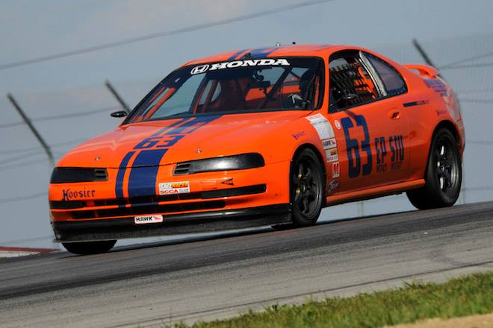
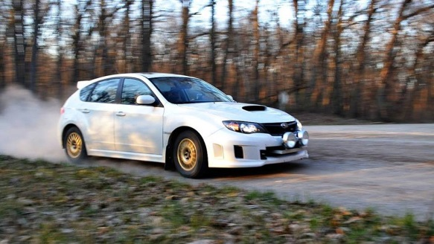
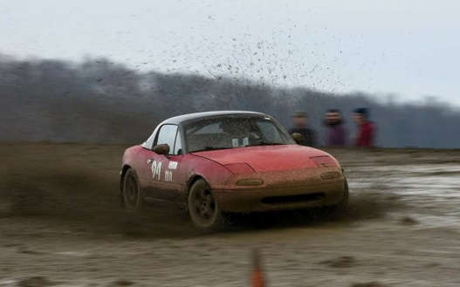
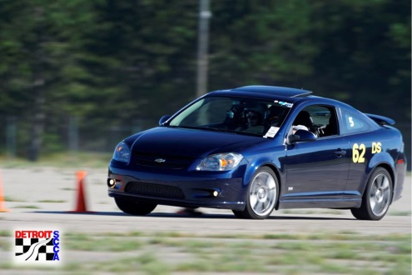
2021 Annual General Membership Meeting
Assistant RE – Cindy Wisner
RE- Frank Putman
Race!
Rally!
RallyCross!
Solo!

Slide 35
WELCOME
2021 Annual Membership Meeting
ARTICLE VI -- RIGHTS OF MEMBERS
Section 1: Annual Business Meeting
An Annual Business Meeting of Members shall be held each year, during the month of March, at a time and place designated by the Region’s Board. Notification of the time, place and agenda for the annual business meeting must be made either in the Region’s Newsletter or on the Region’s Website for at least one (1) month preceding the meeting. The purpose shall be to allow the members to hear annual reports by officers and committees concerning business conducted during the previous fiscal year as well as other business that may come before the meeting.

Slide 36

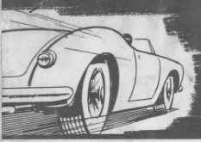
Agenda:
Board and Chiefs
Club Accomplishments 2020
Region Needs
2021 Schedules (Race, Rally, RallyX, Solo)
Detroit Grand Prix 2021
Formula SAE 2021 Update
Street Survival School
Membership Report & Information
Financial Report

Slide 37
Board of Directors
2020
Regional Executive Frank Putman
Assistant Regional Executive Cindy Wisner
Secretary Brian Thorpe
Treasurer Dr. Jennifer Glass
Director at Large Keith Armitage
Director at Large Scott Harvey
Director at Large Greg Valade
Director at Large Ray Jason
Race Director Nick Aranda
Rally Director Piotr Roszczenko
RallyCross Director Matt Wolfe
Solo Director John Li
Financial Director Dan Assenmacher

Slide 38
Board of Directors
2021
Regional Executive Frank Putman
Assistant Regional Executive Cindy Wisner
Secretary Brian Thorpe
Treasurer Greg Valade
Director at Large Keith Armitage
Director at Large Scott Harvey
Director at Large Alejandro Della Torre
Director at Large Ray Jason
Race Director Nick Aranda
Rally Director Piotr Roszczenko
RallyCross Director Matt Wolfe
Solo Director John Li
Financial Director Dan Assenmacher

Slide 39
Specialty Chiefs
2021
Chief of Membership Steve Balanecki
Open Exhaust Brian Thorpe
Webmaster Matt Kowalski
Worker points keeper Steve Balanecki
Chief of Solo Registration Tammy Breece
Chief of Registration Mary Shiloff
Grand Prix Race Chairman Jerry Shiloff
Chiefs of Emergency Services Greg Lewandowski
Brian Long
Rick Stockton
Chief of F&C Cindy Wisner
Chief of Licensing Jerry Shiloff

Slide 40
Club Accomplishments 2020
SCCA Mission Statement: To consistently provide fun, fair, and safe activities through diverse opportunities for the automotive and motorsports enthusiasts.
2020 was a highly successful year
>30 Events
>200 Entries
Notable events
Held Drivers School and Flagging School
Renewed Detroit Region SCCA Racing at Waterford Hills
USRRC United States Road Rally Challenge

Slide 41
Region Needs
We need help with event sites!
Contact Race, Rally, RallyCross and Solo Directors
We also need sites for
* display of trophies and
* storage of equipment and vehicles
Contact Keith Armitage

Slide 42
2021 Schedule: Race
Road Racing Director Nicholas Aranda Nick.k.aranda@outlook.com
2021 Schedule: TSD Road Rally
Road Rally Director Piotr Roszczenko piotr.scca@gmail.com

Slide 43
2021 Schedule: RallyCross
Rallycross Director Matt Wolfe lonewolfe171@gmail.com
2021 Schedule: Solo (AutoCross)
Autocross Director John Li jli@jleez.net

Slide 44
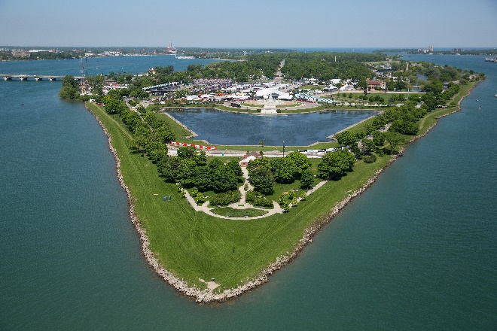

June 11- June 13 2021 Detroit Grand Prix
The 2021 Chevrolet Detroit Grand Prix presented by Lear will be held on
June 11 – June 13, 2021
Registration for SCCA workers is open by invitation
For more information, visit www.DetroitGP.com and follow our social media pages on Facebook, Twitter and Instagram.

Slide 45
Chairman Jerry Shiloff jshiloff@comcast.net
ABOUT THE CHEVROLET DETROIT GRAND PRIX
Presented by Lear
The Detroit Grand Prix is a 501(c)3 organization and a subsidiary of the Downtown Detroit Partnership. Scheduled for June 11-13, 2021 at Belle Isle Park, the event will include the Chevy Dual in Detroit featuring the cars of the NTT INDYCAR SERIES, the Chevrolet Sports Car Classic with the exotic sports cars of the IMSA WeatherTech SportsCar Championship and the rising stars of the Indy Lights Presented by Cooper Tires Series.

Slide 46



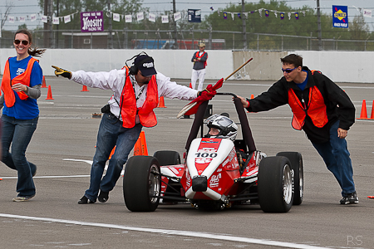
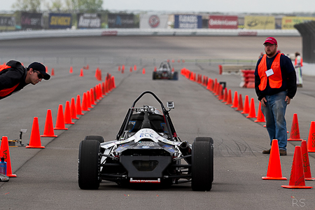
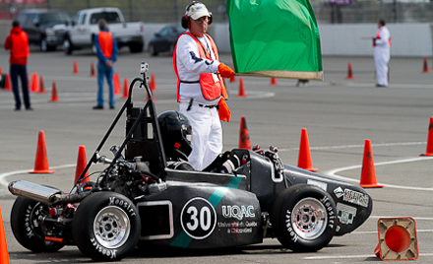
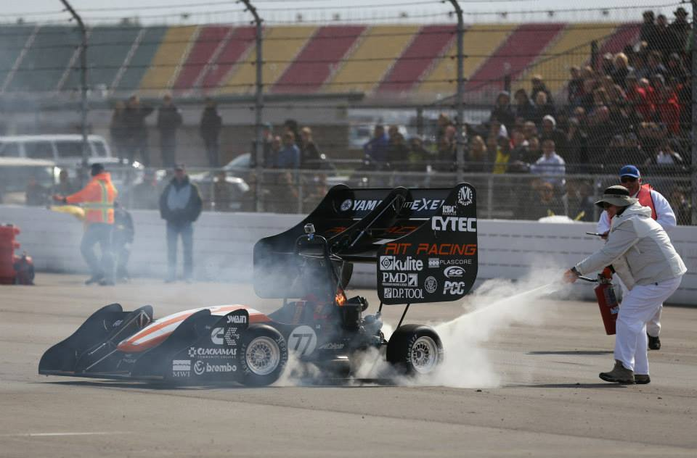
July 7-10, 2021 at Michigan International Speedway
Volunteers are NEEDED
2

Slide 47

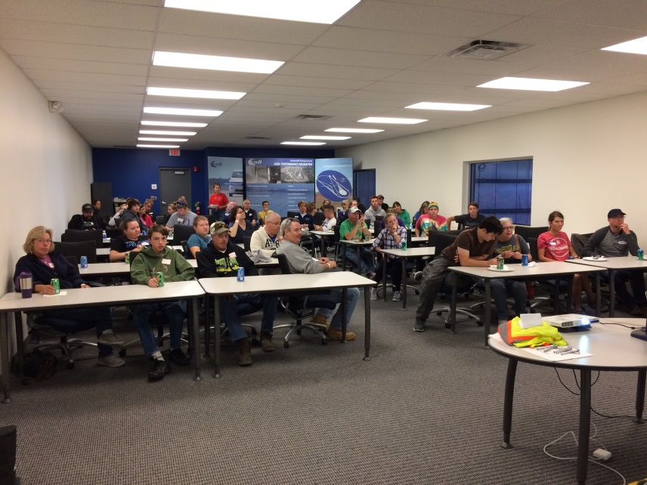
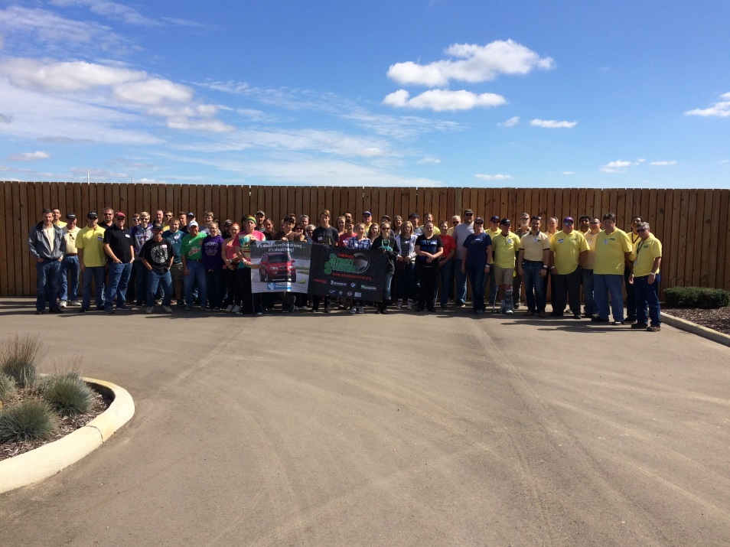
Street Survival
Eric Penn
Keith Armitage
Date to be announced

Slide 48
Membership Review:
Chief of Membership Steve Balanecki 248-770-9469 membership@drscca.org
Membership as of 12/31/2020 – 1,313
New members in 2020 - 308
You can update your membership information online at www.scca.com
Click on “SCCA Members” to access the Member Account Portal Log In
Enter your membership number and password

Slide 49
2020 Financial Summary
Presented by Greg Valade, Treasurer
2020 Treasurer: Dr. Jennifer Glass
Financial information and the financial summary for 2020 will be posted on DRSCCA.org

Slide 50


2020 Financial Summary
 | December 2019 | December 2020
ASSETS
Bank Accounts | $177,982 | $172,134
Prepaid Expenses | $2,730 | $3,030
Total Current Assets | $180,712 | $175,164
Capital Equipment | $163,670** | $163,670
TOTAL ASSETS | $344,539 | $338,834
LIABILITIES
Accounts Payable | $3,270 | $0
Event Credits | $40 | $40
Reserve Fund | $29,705 | $25,406
TOTAL LIABILITIES | $33,015 | $25,447
TOTAL EQUITY | $311,524 | $313,387

Slide 51
Financial Report: 2020 Summary
Program Summary
Category | Amount
Race | $790
Rally | $-299
RallyCross | $1,638
SOLO | $10,980
Special Events | $0
Membership | $9,541.67
Other Activity | $14,218
TOTAL NET INCOME | $29,579
2020 Capital Adjustments
Investment | Adjustment to Capital Equipment
TOTAL CAPITAL ADJUSTMENTS | $0
2020 Major Expenses
Investment | Amount
Banquet | $3,105
Equipment Maintenance | $4,236

Slide 52
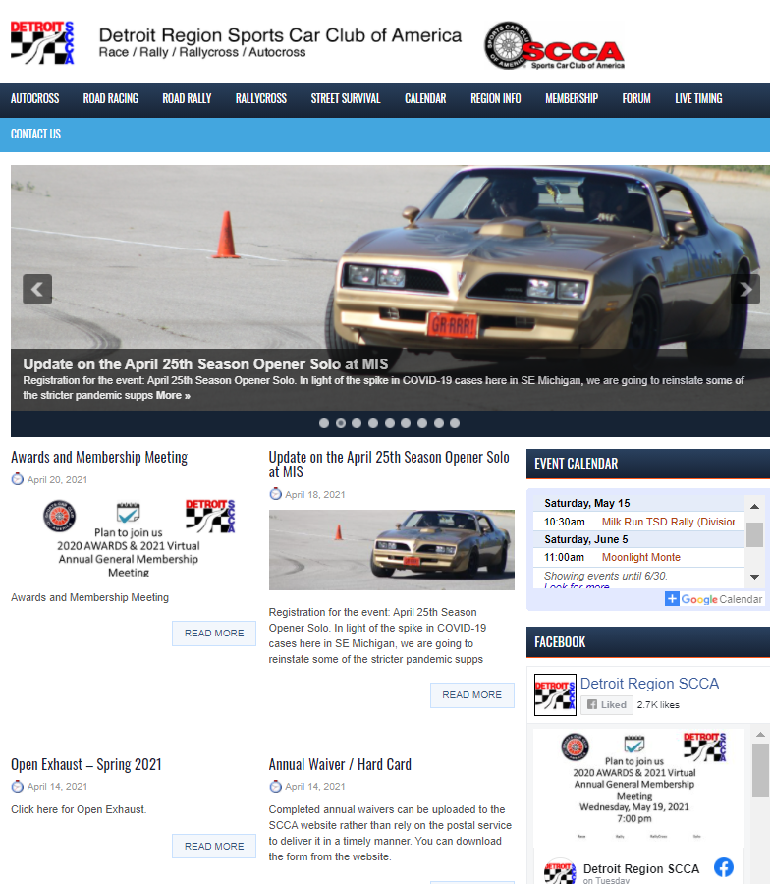
WE WANT TO SEE YOU AT AN EVENT!

Slide 53
Appendix
Questions?
**********************************************

Slide 54
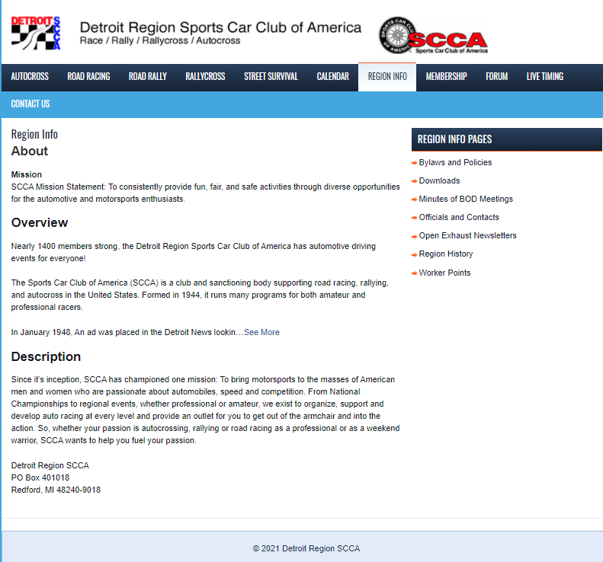
Emails and Contact Information

Slide 55
Membership Information
Automatic renewal when paying by credit card
Member receives notification prior to membership expiration
Must notify headquarters to cancel automatic renewal
Family membership renewal
All family members will be listed on the renewal form
Any credits for each family member will be displayed
Service Awards are presented for every five years of membership
Wheel pin presented with 5 year tab
Mailed at the beginning of the anniversary month
awards mailed in 2020

Slide 56
Membership Information: Worker Points
Each worker point is worth $5.00
Worker points can be redeemed for
Membership renewal,
Registration fees for region events including the annual banquet,
For merchandise offered by
Solo Performance
SCCAGear.com

Slide 57
Membership Information: Worker Points
Each worker point is worth $5.00
Worker points can be redeemed for
Membership renewal,
Registration fees for region events including the annual banquet,
For merchandise offered by
Solo Performance
SCCARegionGear.com

Slide 58
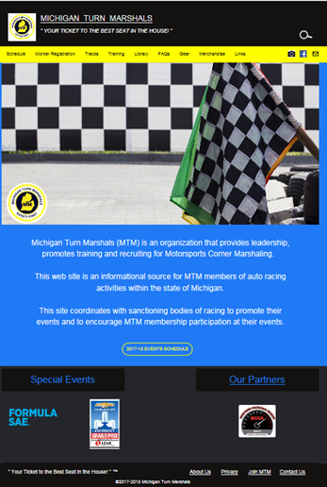
Michigan Turn Marshals

Slide 59
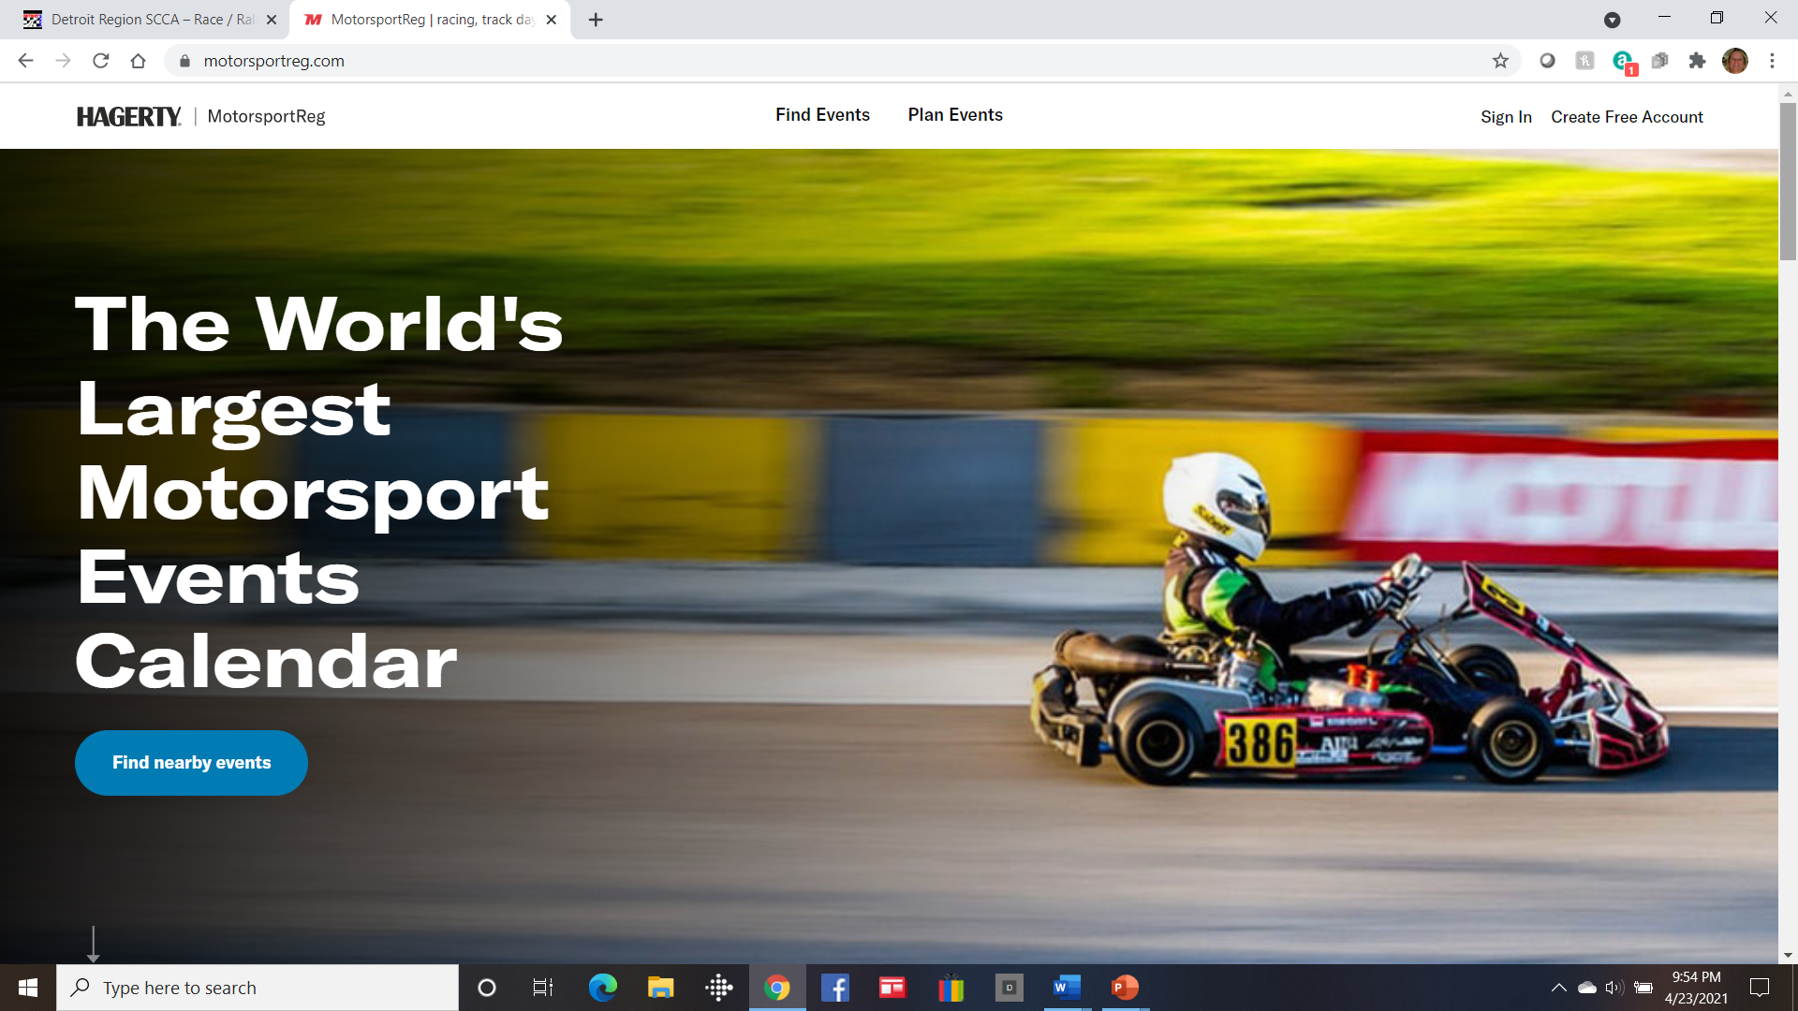
Find Events and register
https://www.motorsportreg.com/

Slide 60

